Slide 1
CCNA 7.0
Product Overview
Updated Feb 2020

Slide 2

CCNA Version 7.0
Enhanced Course Design
Accelerate Path to Job Readiness
Improved Outcomes
Lab Equipment
Logistics and Timing

Slide 3



Version 7 Will Be The Best Yet!
Enhanced Course Design
Accelerated Path to Job Readiness
Improved Outcomes

Slide 4

CCNA Curriculum
Curriculum Overview
Career Prep
Learning Components
The courses in the CCNA Version 7.0 curriculum help students develop a comprehensive foundation for designing, securing, operating, and troubleshooting modern computer networks, on the scale from small business networks to enterprise networks, with an emphasis on hands-on learning and essential career skills like problem solving and collaboration.
By the end of the CCNA course series, students gain practical, hands-on experience preparing them for the CCNA certification exam and career-ready skills for associate-level roles in the Information & Communication Technologies (ICT) industry.
Series of 3 courses:
Introduction to Networks (ITN)
Switching, Routing, and Wireless Essentials (SRWE)
Enterprise Networking, Security, and Automation (ENSA)
Hands-on labs and Cisco Packet Tracer network simulation activities
Videos, activities, and quizzes reinforce learning
Exams to measure learning outcomes
Assessment features to ensure exam security and integrity
Features
Certification
Aligned
Target Audience: Students interested in pursuing an IT-related career
Prerequisites: None. Vocational students often take IT Essentials or equivalent knowledge prior to CCNA
Course Delivery: Instructor-led
Estimated Time to Complete: 200 hours
Recommended Next Course: CCNP Enterprise Core, CCNA CyberOps, DevNet Associate, Python or Emerging Tech Workshops

Slide 5
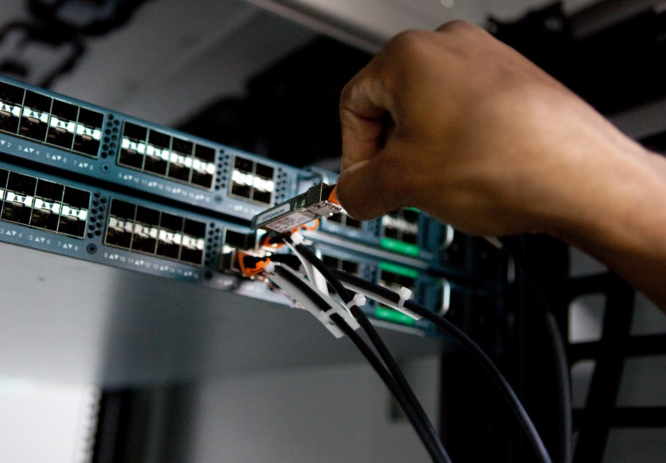
CCNA: Introduction to Networks
Course Overview
The first course in the CCNA curriculum introduces the architectures, models, protocols, and networking elements that connect users, devices, applications and data through the Internet and across modern computer networks - including IP addressing and Ethernet fundamentals.
Benefits
By the end of the course, students can build simple local area networks (LAN) that integrate IP addressing schemes, foundational network security, and perform basic configurations for routers and switches.
Features
Target Audience: Secondary vocational students, 2-year and 4-year college students in Networking or Engineering
Prerequisites: None
Instructor Training Required: Yes
Languages: English
Course Delivery: Instructor-led
Course Recognitions: Certificate of Completion, Letter of Merit, Digital Badge
Estimated Time to Complete: 70 hours
Recommended Next Course: CCNA: Switching, Routing, and Wireless Essentials
Learning Components
17 modules
24 hands-on labs
31 Cisco Packet Tracer activities
36 videos
10 syntax checkers
13 interactive activities
64 CYU quizzes
17 module exams
6 module group exams
1 final exam

Slide 6
CCNA: Switching, Routing, and Wireless Essentials
Course Overview
The second course in the CCNA curriculum focuses on switching technologies and router operations that support small-to-medium business networks and includes wireless local area networks (WLAN) and security concepts.
Benefits
Students learn key switching and routing concepts. They can perform basic network configuration and troubleshooting, identify and mitigate LAN security threats, and configure and secure a basic WLAN.
Features
Target Audience: Secondary vocational students, 2-year and 4-year college students in Networking or Engineering
Prerequisites: None
Instructor Training Required: Yes
Languages: English
Course Delivery: Instructor-led
Course Recognitions: Certificate of Completion, Letter of Merit, Digital Badge
Estimated Time to Complete: 70 hours
Recommended Next Course: CCNA: Enterprise Networking, Security, and Automation
Learning Components
16 modules
14 hands-on labs
31 Cisco Packet Tracer activities
15 videos
19 syntax checkers
1 interactive activity
36 CYU quizzes
16 module exams
5 module group exams
1 final exam

Slide 7
CCNA: Enterprise Networking, Security, and Automation
Course Overview
The third CCNA course describes the architectures and considerations related to designing, securing, operating, and troubleshooting enterprise networks – including wide area network (WAN) technologies & quality of service (QoS) mechanisms for secure remote access, along with software-defined networking, virtualization, & automation concepts supporting network digitization.
Benefits
Students gain skills to configure and troubleshoot enterprise networks, and learn to identify and protect against cybersecurity threats. They are introduced to network management tools and learn key concepts of software-defined networking, including controller-based architectures and how application programming interfaces (APIs) enable network automation.
Features
Target Audience: 2-year and 4-year college students in Networking or Engineering
Prerequisites: None
Instructor Training Required: Yes
Languages: English
Course Delivery: Instructor-led
Course Recognitions: Certificate of Completion, Letter of Merit, Digital Badge
Estimated Time to Complete: 70 hours
Recommended Next Course: CCNP Enterprise Core
Learning Components
14 modules
12 hands-on labs
29 Cisco Packet Tracer activities
32 videos
13 syntax checkers
2 interactive activities
53 CYU quizzes
14 module exams
5 module group exams
1 final exam
1 practice exam for CCNA certification exam

Slide 8
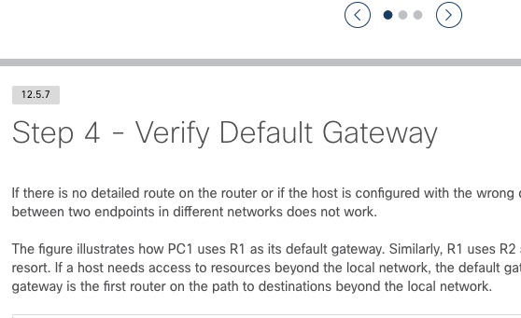
Enhanced Course Design
Module
Module
Expand
Expose
Module
Module
Apply
Practice
Module
Modular Design
Self-contained units
Targeted learning of skills
Learning Effectiveness
Better student engagement
Designed for skills progression
User Experience
Improved student view and navigation
Easier instructor content management

Slide 9
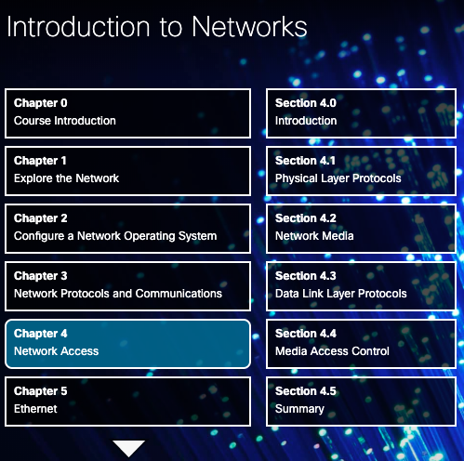
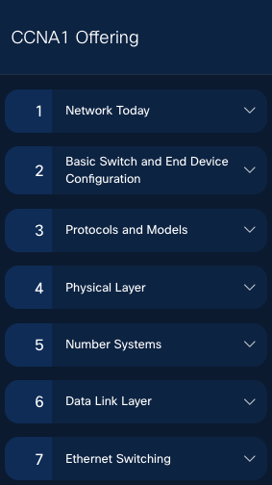
Enhanced Course Design
Introducing modules for better organization
Topics are grouped together
Find content more easily
A module is an integrated unit of learning that targets a common set of competencies or skills.
Module size depends on the competency and number of topics.
Example: CCNA: ITN (Version 6) Chapter 4 is re-organized to CCNA: ITN (Version 7) Modules 4 and 6.

Slide 10
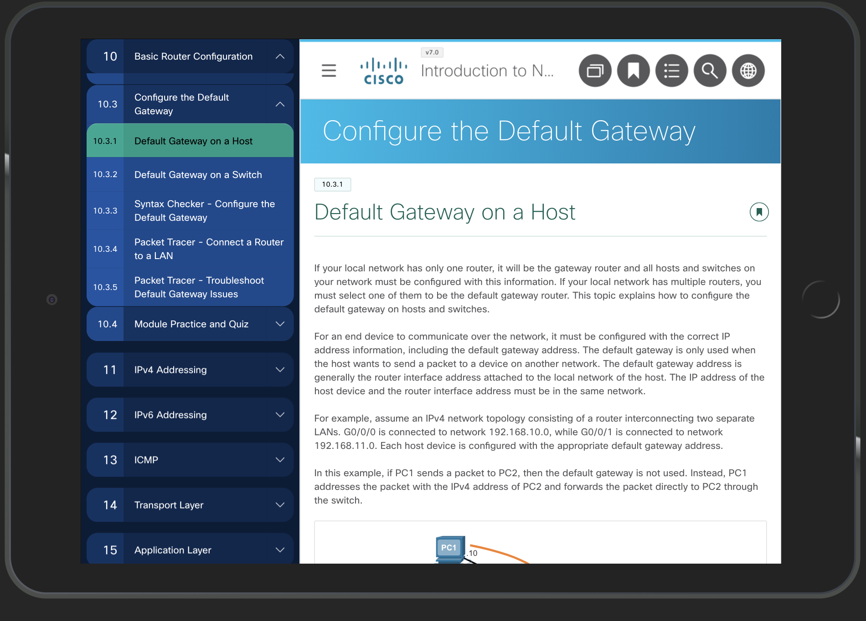
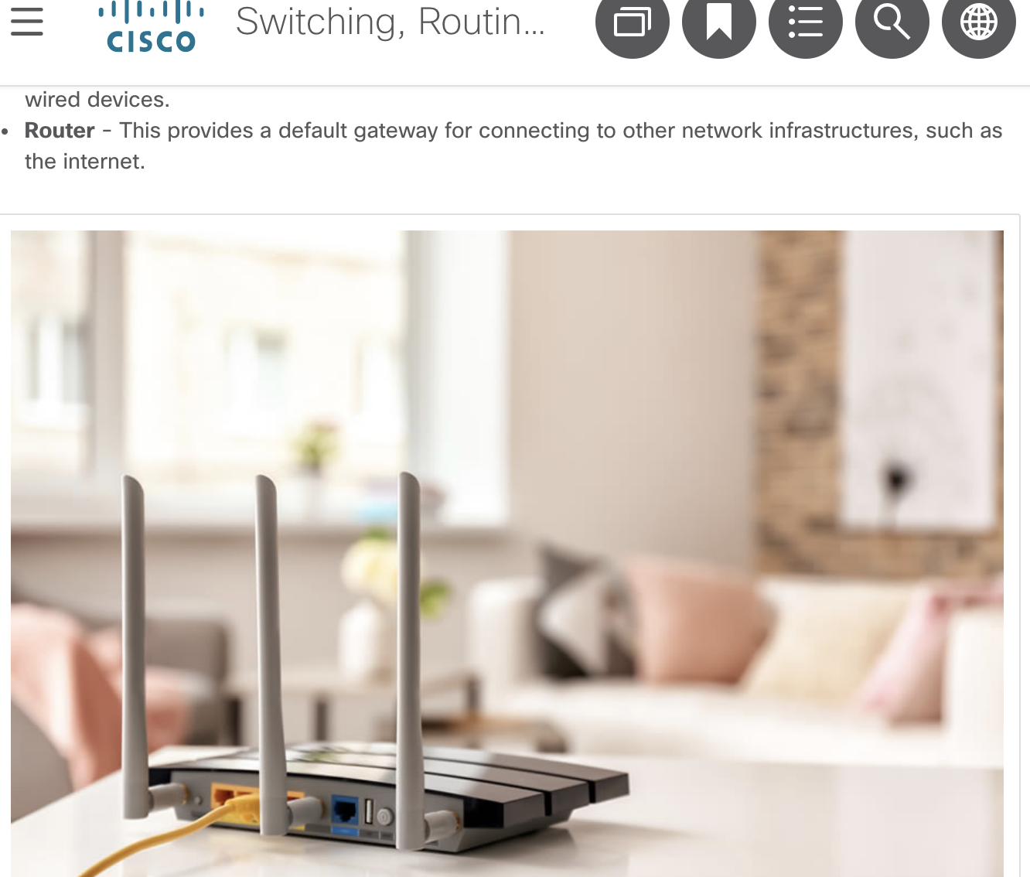
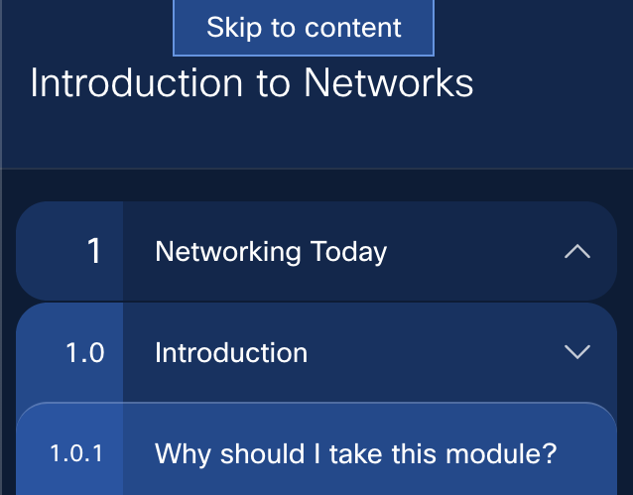
Enhanced Course Design
Accessibility Enhancements
“Small wireless router with three visible antenna and ports.”
Redesigned User Interface
Developed for Web Content Accessibility Guidelines 2.1
New sidebar navigation
Mobile-friendly
Performance enhancements
Improved color contrast
Enhancements for Screen Readers
Media descriptions and transcripts throughout
Descriptions & transcripts tied directly to user interface
Conversion to HTML- screen reader can read tables, command windows, Syntax Checkers
Better Keyboard Accessibility
‘Skip to Content’ sidebar navigation
All activities are now keyboard accessible
New, accessible header with all user functions

Slide 11
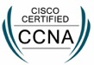
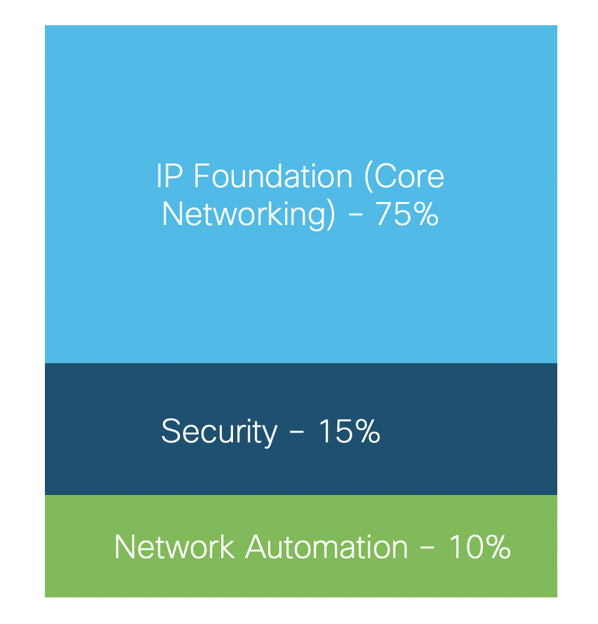
Build Critical Skills for Today - and Tomorrow
Certification
Alignment
As of Feb 2020, Cisco has a new, consolidated CCNA certification evolved for the New Network
NetAcad curriculum has evolved to stay aligned
In CCNA 7.0, students gain critical networking skills, plus foundations for security and automation
CCNA 7.0 practice exams and activities prepare learners for the new exam
Associate Level
One Exam

Slide 12
CCNA 7.0 Course Outlines
Intro to Networks (ITN)
Switching, Routing, and Wireless Essentials (SRWE)
Enterprise Networking, Security and Automation (ENSA)
Complementary Options
Networking Today
Basic Switch and End Device Configuration
Protocol Models
Physical Layer
Number Systems
Data Link Layer
Ethernet Switching
Network Layer
Address Resolution
Basic Router Configuration
IPv4 Addressing
IPv6 Addressing
ICMP
Transport Layer
Application Layer
Network Security Fundamentals
Build a Small Network
Basic Device Configuration
Switching Concepts
VLANs
Inter-VLAN Routing
STP
Etherchannel
DHCPv4
SLAAC and DHCPv6 Concepts
FHRP Concepts
LAN Security Concepts
Switch Security Configuration
WLAN Concepts
WLAN Configuration
Routing Concepts
IP Static Routing
Troubleshoot Static and Default Routes
Single-Area OSPFv2 Concepts
Single-Area OSPFv2 Configuration
WAN Concepts
Network Security Concepts
ACL Concepts
ACLs for IPv4 Configuration
NAT for IPv4
VPN and IPsec Concepts
QoS Concepts
Network Management
Network Design
Network Troubleshooting
Network Virtualization
Network Automation
CCNP Enterprise (ENCOR, ENARSI)
or
CCNA Security / CCNA CyberOps
or
DevNet Associate
or
Python / ETWs
or lead with
IT Essentials
__ New/significantly changed content

Slide 13
Accelerated Path to Job Readiness
NEW!
Module |  | Module Group Assessments
Module 1 | Networking Today | Basic Network Connectivity and Communications
Module 2 | Basic Switch and End Device Configuration
Module 3 | Protocol Models
Module 4 | Physical Layer | Ethernet Concepts
Module 5 | Number Systems
Module 6 | Data Link Layer
Module 7 | Ethernet Switching
Module 8 | Network Layer | Communicating Between Networks
Module 9 | Address Resolution
Module 10 | Basic Router Configuration
Module 11 | IPv4 Addressing | IP Addressing
Module 12 | IPv6 Addressing
Module 13 | ICMP
Module 14 | Transport Layer | Network Application Communications
Module 15 | Application Layer
Module 16 | Network Security Fundamentals | Building and Securing a Small Network
Module 17 | Build a Small Network
Module
Objectives
Introduction to Networks (ITN)

Slide 14
Accelerated Path to Job Readiness
Module |  | Module Group Assessments
Module 1 | Basic Device Configuration | Switching Concepts and VLANS
Module 2 | Switching Concepts
Module 3 | VLANs
Module 4 | Inter-VLAN Routing
Module 5 | STP | Redundant Networks
Module 6 | Etherchannel
Module 7 | DHCPv4 | Available and Reliable Networks
Module 8 | SLAAC and DHCPv6 Concepts
Module 9 | FHRP Concepts
Module 10 | LAN Security Concepts | L2 Security and WLANs
Module 11 | Switch Security Configuration
Module 12 | WLAN Concepts
Module 13 | WLAN Configuration
Module 14 | Routing Concepts | Routing Concepts and Configuration
Module 15 | IP Static Routing
Module 16 | Troubleshoot Static and Default Routes
Module
Objectives
Switching, Routing, and Wireless Essentials (SRWE)

Slide 15
Accelerated Path to Job Readiness
Module |  | Module Group Assessments
Module 1 | Single-Area OSPFv2 Concepts | OSPF Concepts and Configuration
Module 2 | Single-Area OSPFv2 Configuration
Module 3 | Network Security Concepts | Network Security
Module 4 | ACLs Concepts
Module 5 | ACLS for IPv4 Configuration
Module 6 | NAT for IPv4
Module 7 | WAN Concepts | WAN
Module 8 | VPN and IPsec Concepts
Module 9 | QoS Concepts | Optimize, Monitor, and Troubleshoot Networks
Module 10 | Network Management
Module 11 | Network Design
Module 12 | Network Troubleshooting
Module 13 | Network Virtualization | Network Virtualization and Automation
Module 14 | Network Automation
Module
Objectives
Enterprise Networking, Security, and Automation (ENSA)

Slide 16

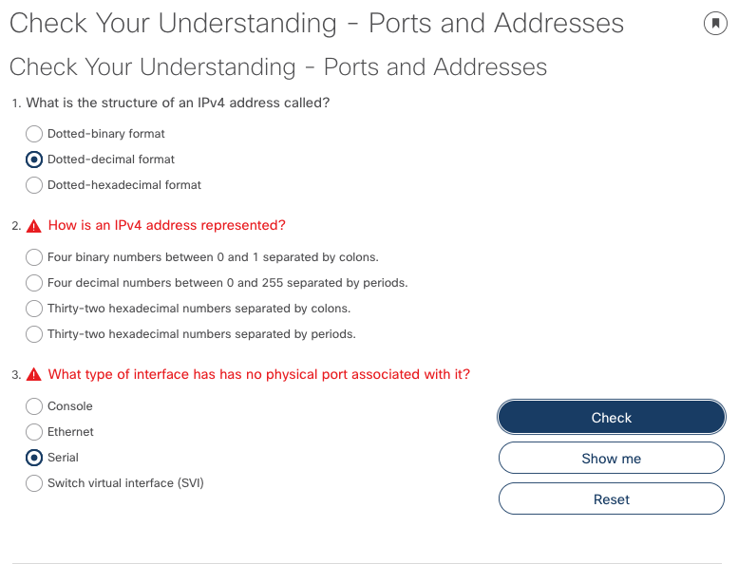
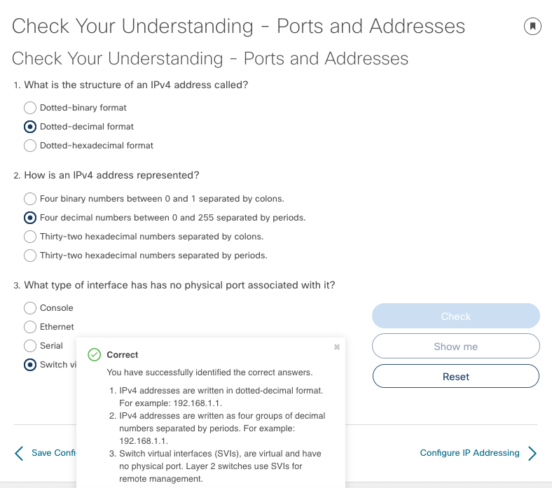
Improved Outcomes
Check Your Understanding
Complete a topic with self-assessment
Gives students the opportunity validate and retain critical knowledge
Use feedback as review

Slide 17
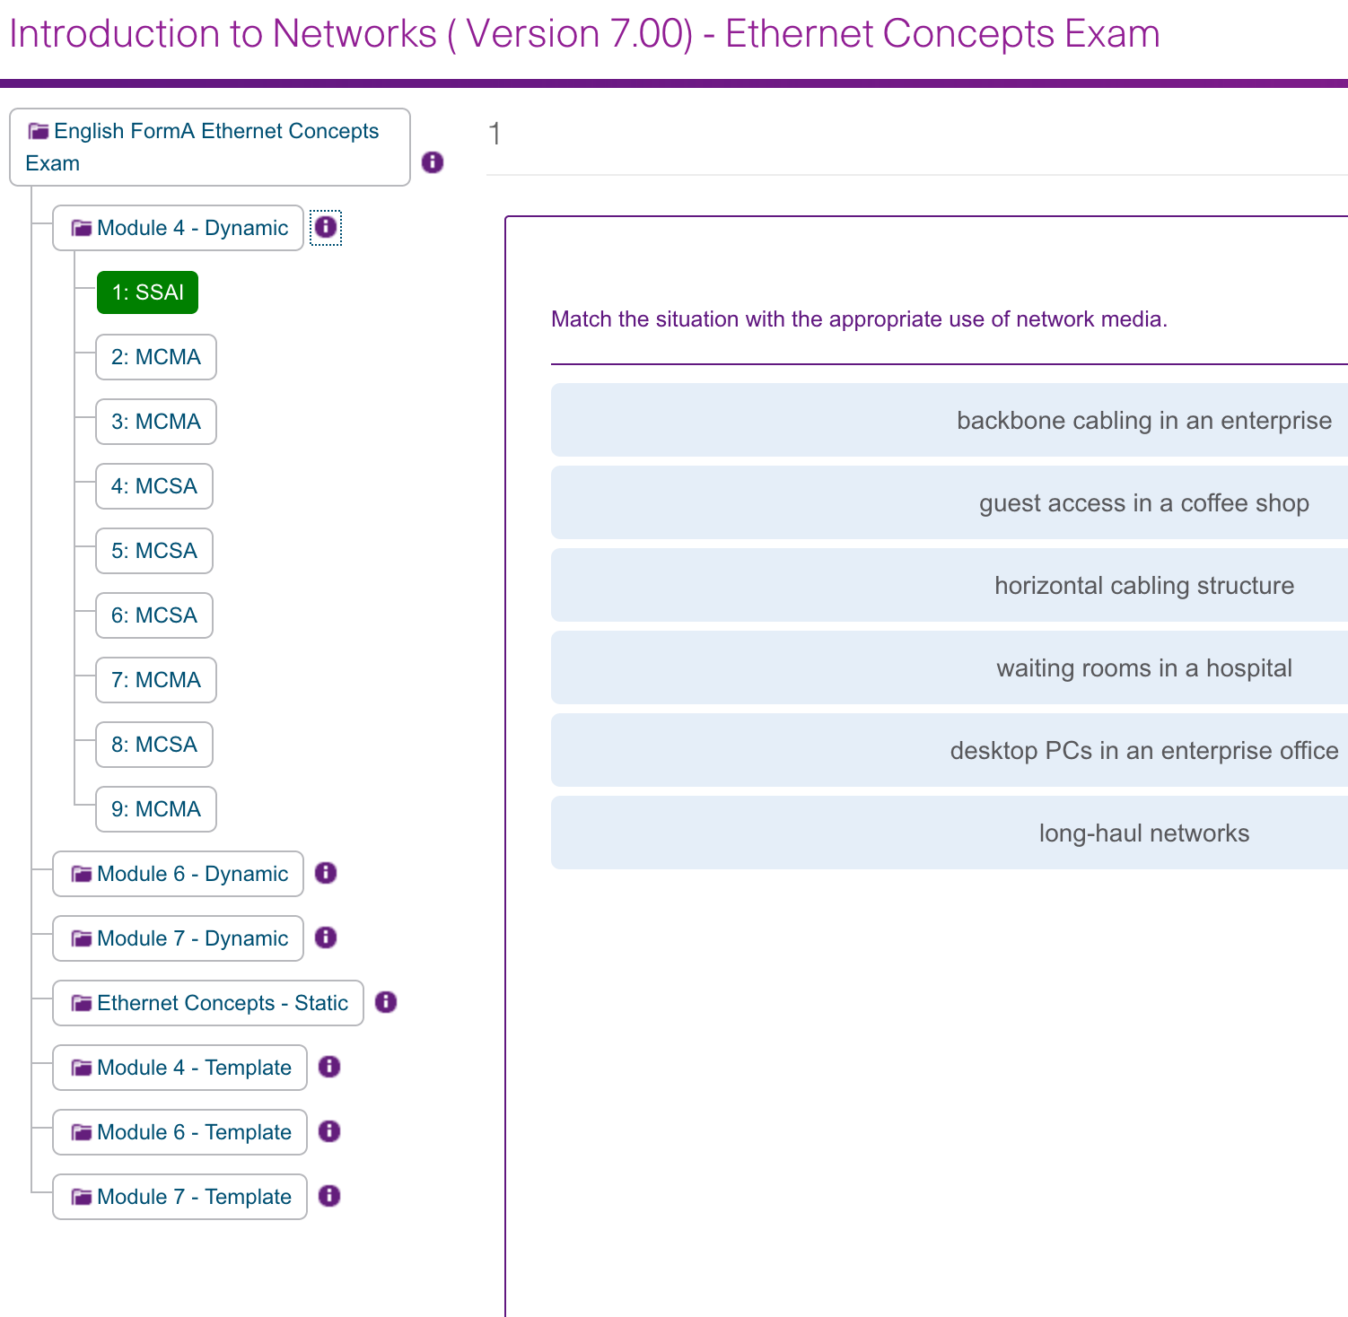
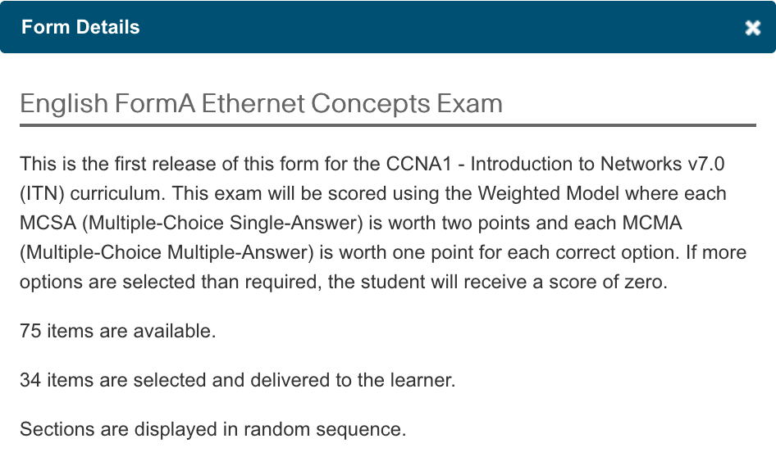
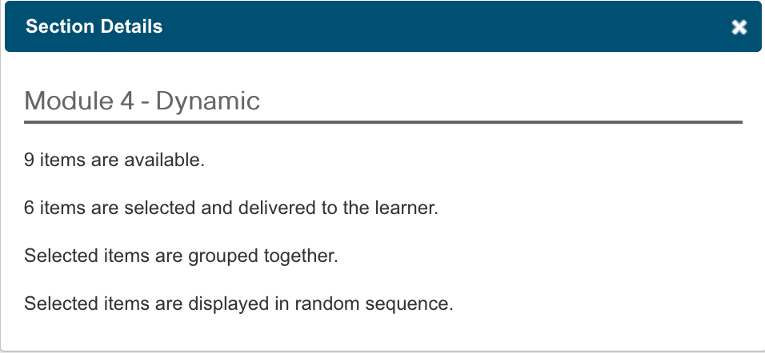
Improved Outcomes
Dynamic Forms - Administer unique exams to each of your students
Exams are dynamically generated from pool of questions, maintaining exam integrity and validity
Available for Module Group exams and Final course exam
Form and Section Details indicate total items available and selected from the pool for students.
Module Group exam items, delivered or not, are available for preview with the assessment viewer

Slide 18
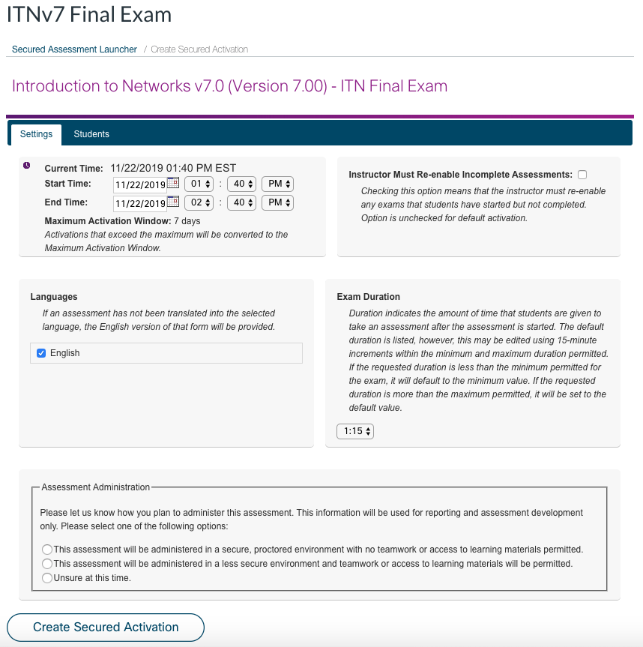
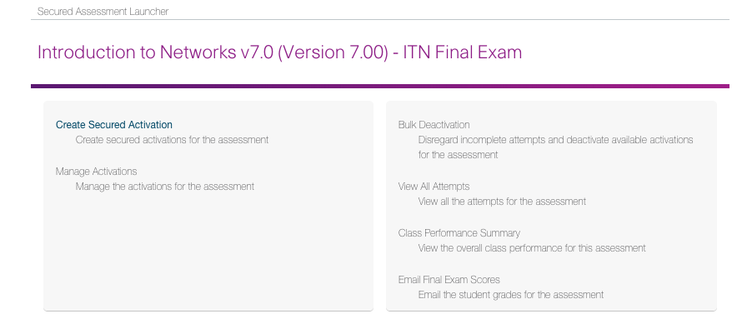
Improved Outcomes
Secured Activation increases final exam security
New Assessment Launcher
Final exams remain secure until administered by instructor
Replaces the Assessment Viewer
For security & integrity, questions are not visible

Slide 19
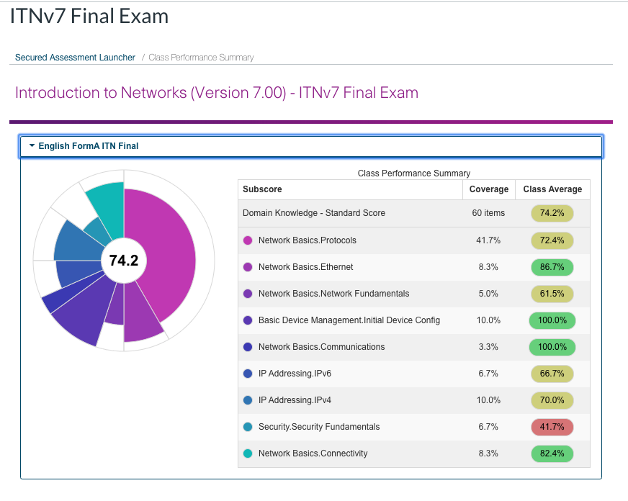
Improved Outcomes
Secured Activation provides useful insights on class performance
Domain Level Reporting
New Class Performance Summary report for instructors
Replaces the Student Performance Summary
See how your students are performing in each domain based on objectives of the modules and course

Slide 20
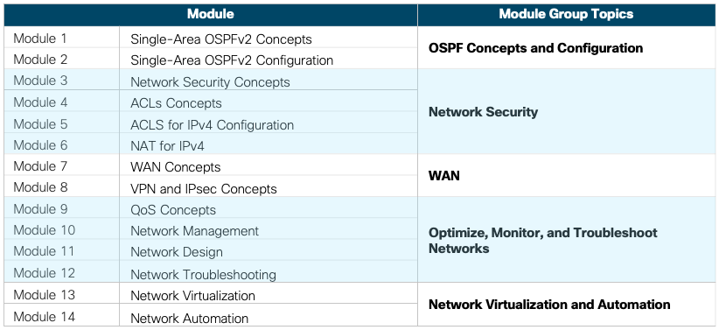
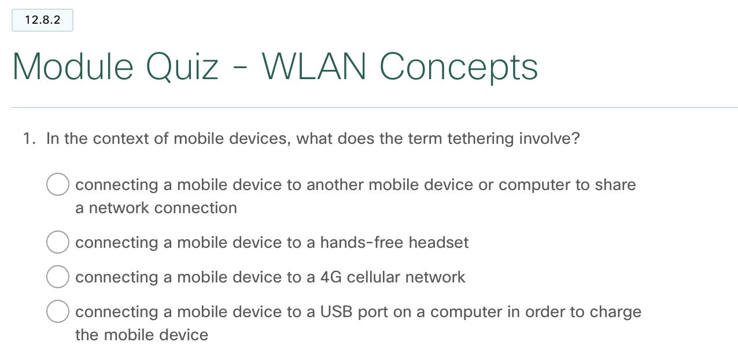
Improved Outcomes
Formative and Summative Assessments guide learning at strategic points
Self-Assessments
Launched by Instructor
Check Your Understanding
Multiple per module
Correct/incorrect scoring and ‘show me’ option
Module Quizzes
1 per module
Correct/incorrect scoring and ‘show me’ option
Module Group Exams
Multiple per course
Final Exams
1 per course
Certification Practice Exams
1 for ENSA course

Slide 21

Lab Equipment

Slide 22










CCNA 6.0 vs 7.0 – Lab Equipment
4221
4221
For CCNA 7.0:
Serial ports not required
Packet Tracer 7.3.0 or higher required
or 4321 or 4331
or 4321 or 4331
PT used for 3-router/switch topologies
2960
2960
Server
Server
SOHO
WiFi Router
New
Various end devices
Various end devices

Slide 23
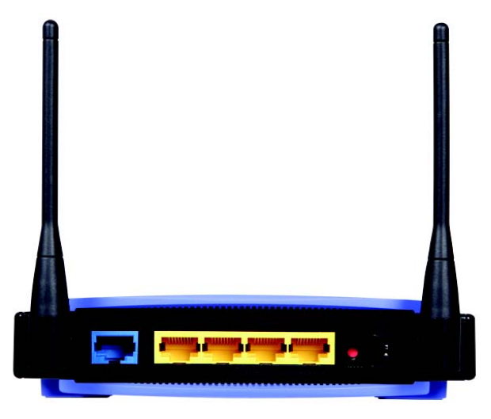
SOHO Wi-Fi Router is Back in CCNA 7.0
1 wireless router (generic brand) with WPA2 support
Configure a Home Network with Wireless
Configure WLAN with WPA2 Encryption
GUI

Slide 24

Can I Teach CCNA v7 with1941/2901 Routers?
Yes, you can use the 1941/2901 Routers, but please note:
CCNA 7.0 Hands-on labs and Skills Assessments (SA) were written using the Cisco 4221 routers
Some modifications for router interface names will be required
Most CCNA 7.0 commands should work, but full regression testing for the 1941 and 2901 was not done
Example:
4221
1941/2901 – Interface names G0/0 & G0/1

Slide 25
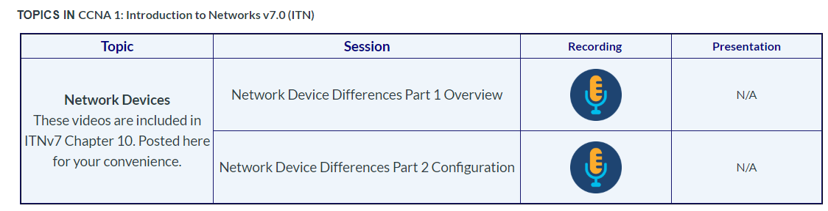
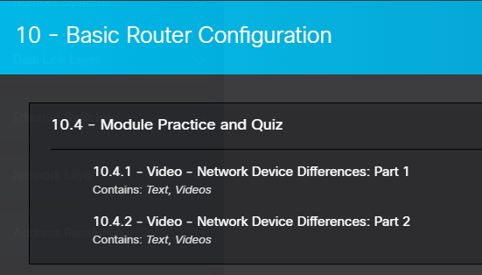
Network Device Differences Videos
Curriculum team created 2 videos available to students and instructors about Network Device Differences – mostly available ports
Available in the IPD Week course on the CCNA 7.0 page for instructors
Student access – CCNA: ITN Module 10 – 10.4.1 and 10.4.2

Slide 26
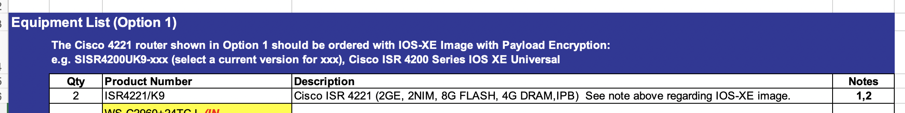
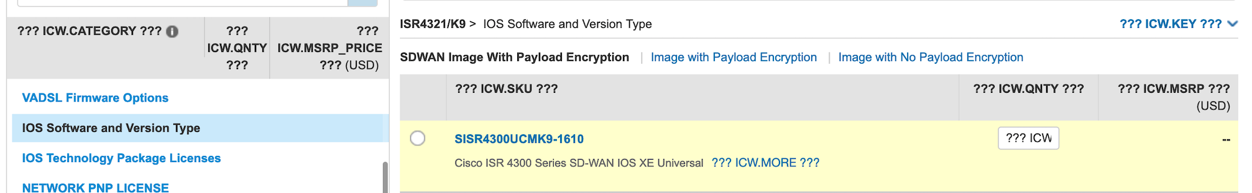
CCNA 7.0 Equipment List – ISR4K IOS-XE Image
Updated equipment list defines IOS-XE image requirements:
Cisco Commerce order tool has 3 tabs for IOS-XE options for ISR4k. First tab is for SD-WAN and should NOT be selected as this is not needed for labs and requires feature license. Second tab includes K9 images that are applicable.
✅

Slide 27
Logistics & Timing

Slide 28
CCNA 7.0 Instructor Qualification Mapping
CCNA R&S 6 Course Current Qualification(s) | CCNA 7 Course Qualification(s) Earned | Materials to Review*
CCNA 1 (Intro to Networks) | CCNA 1 (Intro to Networks) | No additional
CCNA 1 (Intro to Networks) CCNA 2 (Routing & Switching Essentials) | CCNA 1 (Intro to Networks) CCNA 2 (Switching, Routing, and Wireless Essentials) | CCNA 2 (SRWE) 7
CCNA 1 (Intro to Networks) CCNA 2 (Routing & Switching Essentials) CCNA 3 (Scaling Networks) | CCNA 1 (Intro to Networks) CCNA 2 (Switching, Routing, and Wireless Essentials) CCNA 3 (Enterprise Networking, Security, and Automation) | CCNA3 (ENSA) 7 + Bridging Course
CCNA 1 (Intro to Networks) CCNA 2 (Routing & Switching Essentials) CCNA 3 (Scaling Networks) CCNA 4 (Connecting Networks) | CCNA 1 (Intro to Networks) CCNA 2 (Switching, Routing, and Wireless Essentials) CCNA 3 (Enterprise Networking, Security, and Automation) | Bridging Course
CCNA 2 (Routing & Switching Essentials) | CCNA 2 (Switching, Routing, and Wireless Essentials) | CCNA2 (SRWE) 7
CCNA 3 (Scaling Networks) | CCNA 3 (Enterprise Networking, Security, and Automation) | CCNA3 (ENSA) 7
CCNA 4 (Connecting Networks) | CCNA 3 (Enterprise Networking, Security, and Automation) | CCNA3 (ENSA) 7
Instructor Professional Development (IPD) Week Landing Page - https://1040239.netacad.com/courses/863485/pages/ccna-7

Slide 29
CCNA 7.0 Translation Plan
Course | Language *
CCNA Version 7 | Spanish
 | Portuguese
 | French
 | Chinese
 | Russian
 | Arabic
* Translated curricula will be released as available and the CCNA Bridging course will be prioritized in each language.

Slide 30
CCNA Version 6 End of Life
Course | Language * | Last Class Start Date
CCNA Version 6 courses (ITN, RS, ScaN, CN) | English | Jan 31, 2021
 | Spanish | End-of-life dates for translated languages will be announced when each language is released. Dates will be a minimum of 1 year after Version 7 course resources are available.
 | Portuguese
 | French
 | Chinese
 | Russian
 | Arabic

Slide 31
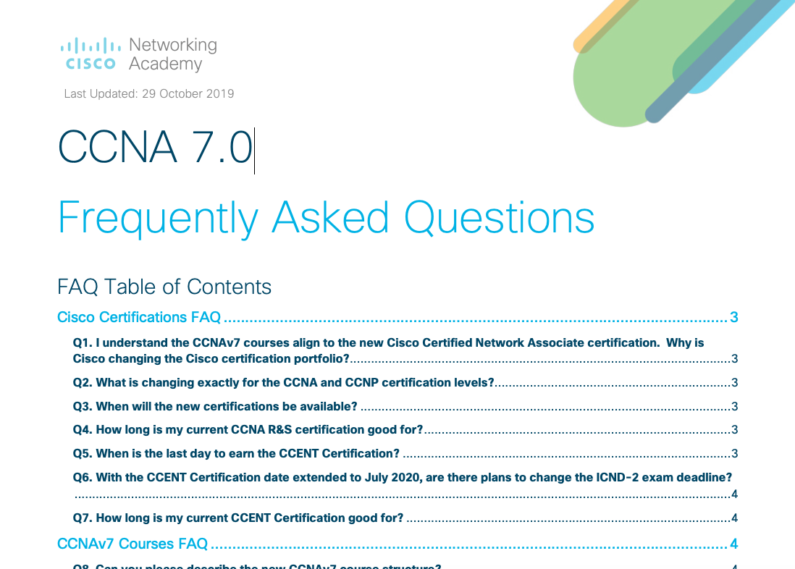
CCNA 7.0 Course Resources
Scope and Sequence
Release Notes
Instructor Planning Guides (includes Instructor PPTs)
Instructor Lab Source Files
Instructor Packet Tracer Source Files
Packet Tracer Activity Source Files
Student Lab Source Files
Student Packet Tracer Source Files
Exam Design Documents
PTSA Design Documents
Access Course Resource Pages through NetAcad.com
https://www.netacad.com/portal/resources/course-resources/ccna-itn
https://www.netacad.com/portal/resources/course-resources/ccna-srwe
https://www.netacad.com/portal/resources/course-resources/ccna-ensa
https://www.netacad.com/portal/resources/course-resources/ccna-bridging

